Slide 1
Thunkable – Green screen

Slide 2
Goals
Insert a To-Do – Design
Add Components
Blocks
Bonus

Slide 3
Goals
Add & View a To-Do list on the page
Insert To-Do (Text)
Choose a Date
Display details as a To-Do

Slide 4
Insert a To-Do - Design
Steps
1. Select the Green screen
2. Go to the Design page
3. Add Component: Text Input
- Name: ‘Todo_Text’, Hint: ‘Type your to-do here’
4. Add Component: Date Input
- Name: ‘Todo_Date’
5. Add Component: 2 buttons
- Name: ‘Button_Add_todo’, Text: ‘Add’, Background
Color (RGBA:65,117,5,1)
- Name: ‘Button_view_todo’, Text: ‘View’, Background
Color (RGBA:65,117,5,1)
5. Add Component: List Viewer
- Name: ‘List_Viewer’
6. Click ‘Web preview’ to see the result

Slide 5
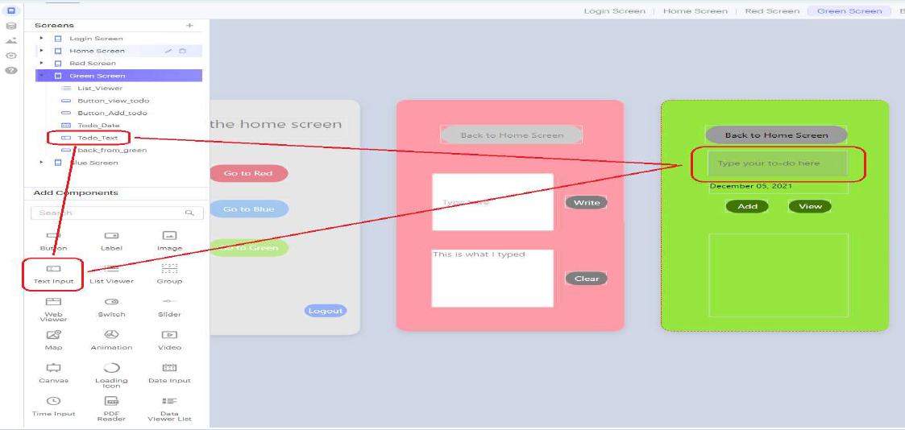
Add Component – Text Input

Slide 6
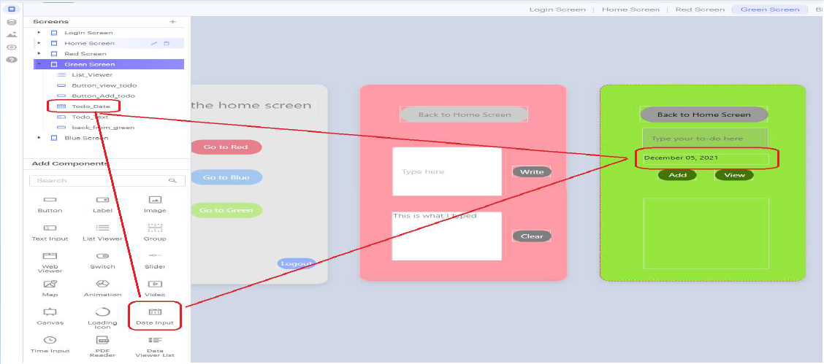
Add Component – Date Input

Slide 7
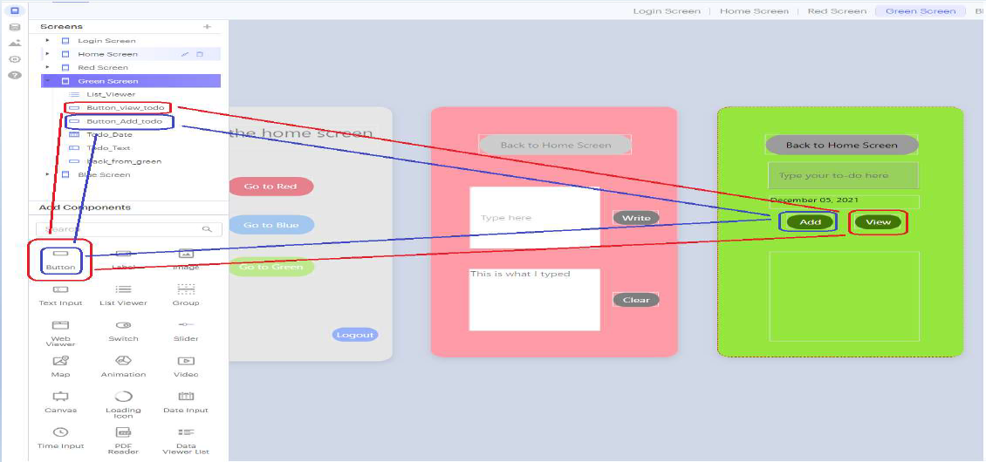
Add Component – Button

Slide 8
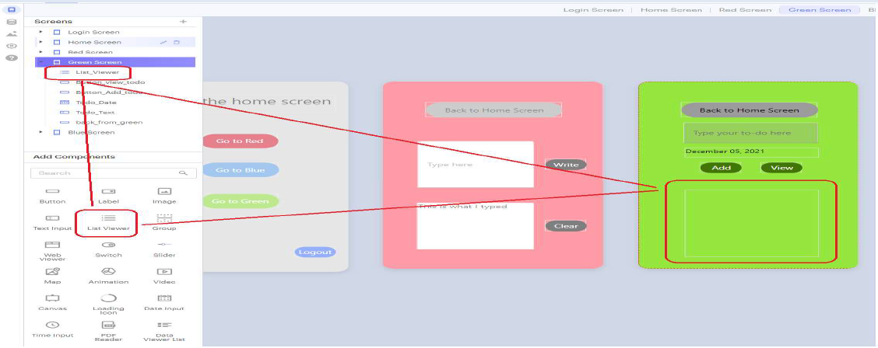
Add Component – List Viewer

Slide 9
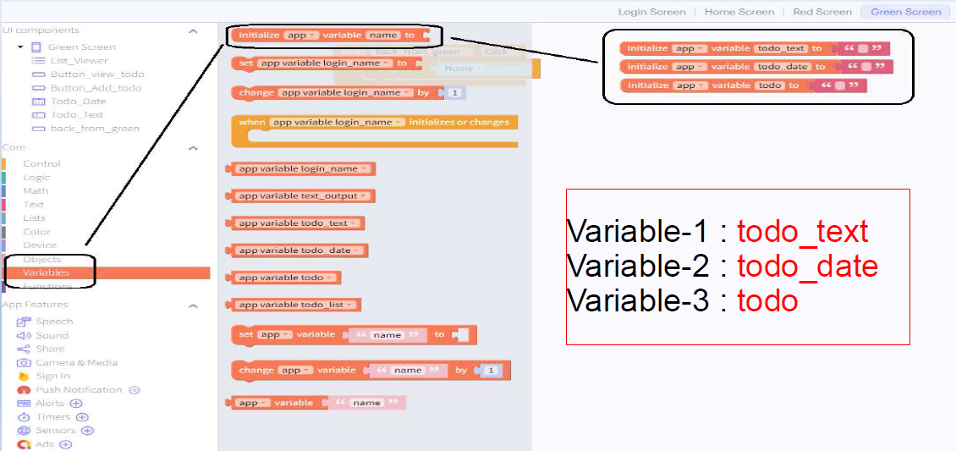
Blocks – Initialize variables

Slide 10
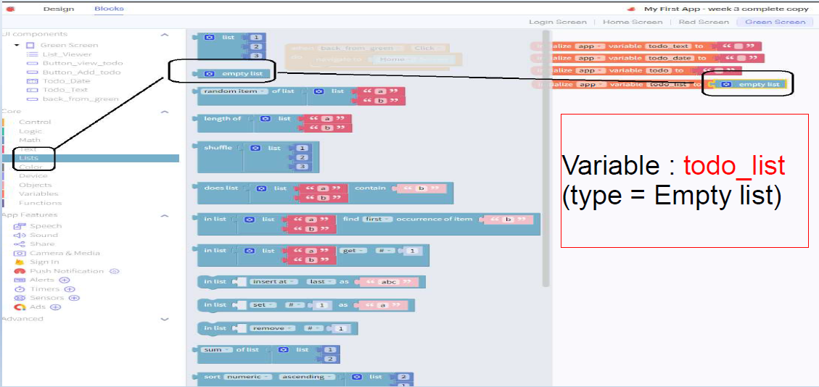
Blocks – Initialize Variables (empty list)

Slide 11
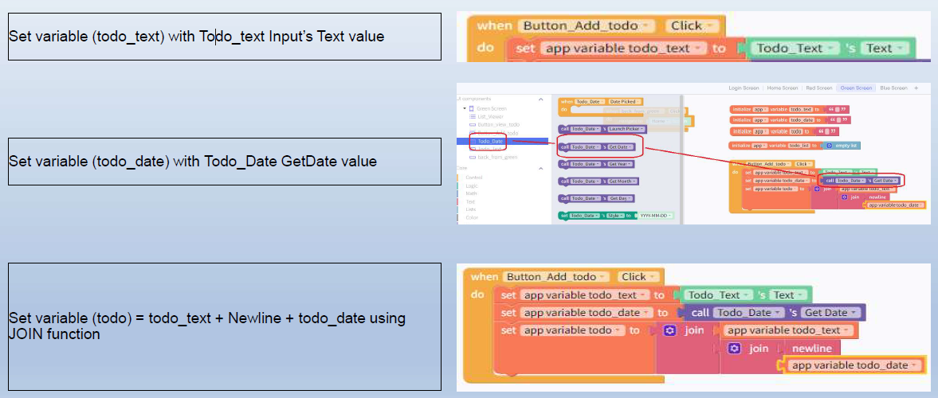
Blocks – Assign text, date to variables

Slide 12
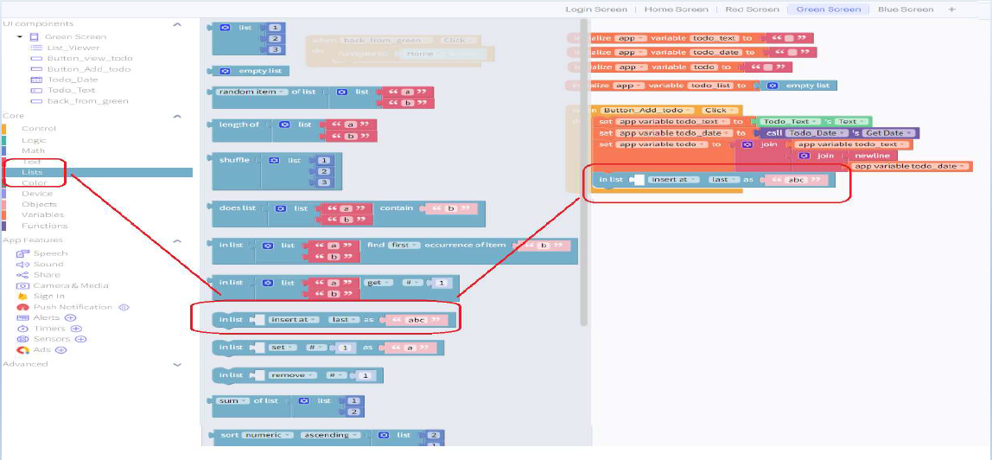
Blocks – Add list addition block

Slide 13
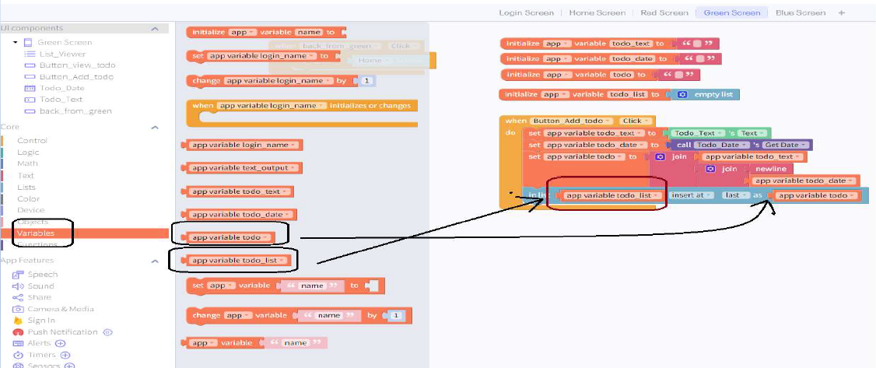
Blocks – Add new variable value in todo_list

Slide 14
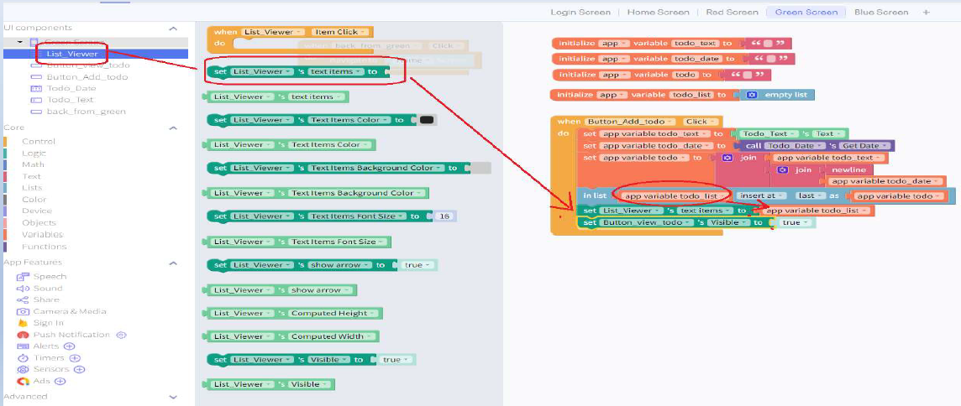
Blocks – Set value of todo_list and make view button visible

Slide 15
Blocks – Show to-dos on click of View button

Slide 16
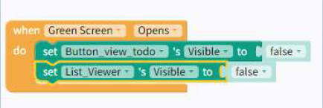
Blocks – Hide the list & View Button when page load as it’s empty

Slide 17
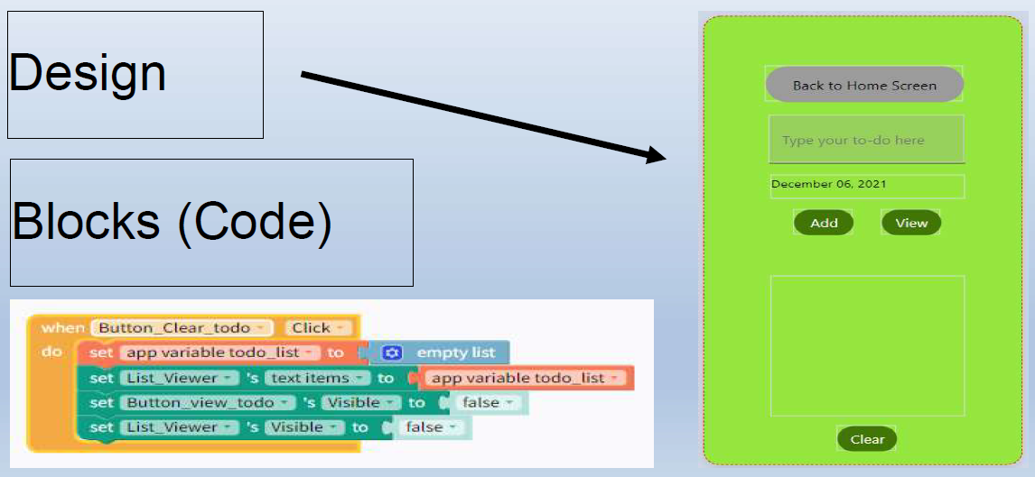
Bonus
Add a clear button to clear the list

