Slide 1
Thunkable – Red Screen

Slide 2
Goals
Insert New Text – Design
Insert New Text – Blocks
Bonus

Slide 3
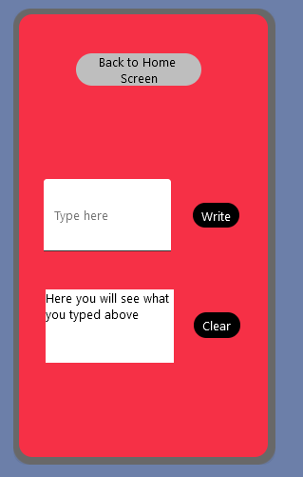
Goals
Insert text
Display text
Control waiting time

Slide 4
Insert New Text - Design
Select the red screen
Go to the Design page
Add a text input element
Name: ‘text_input’, Hint: ‘Type here’
4. Add a label element
Name: ‘text_output’, Text: ‘Here you will see what you typed’
5. Add 2 button elements (you can duplicate)
Name:’ write_button’, Text: ‘Write’
Name: ‘clear_button’, Text: ‘Clear’
6. Click ‘Web preview’ to see the result

Slide 5
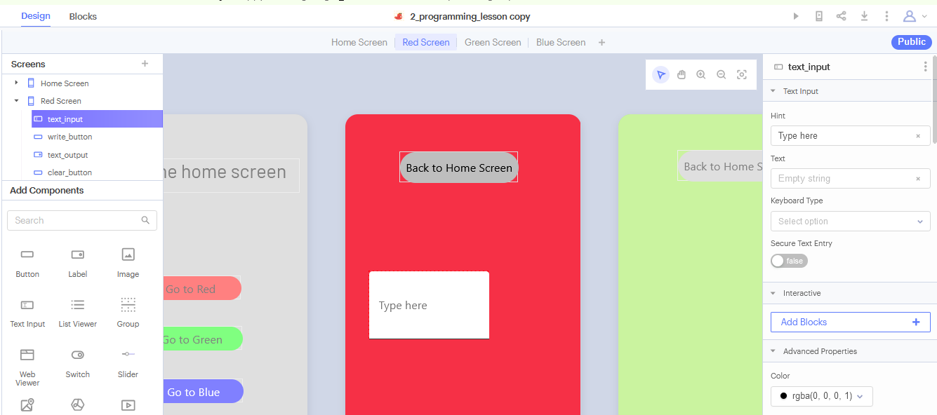
Insert New Text – Text Input

Slide 6
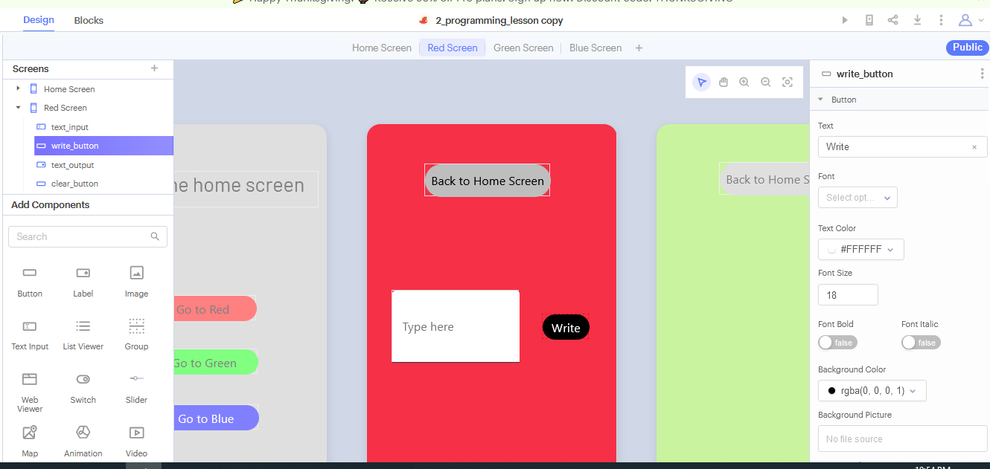
Insert New Text – Write Button

Slide 7
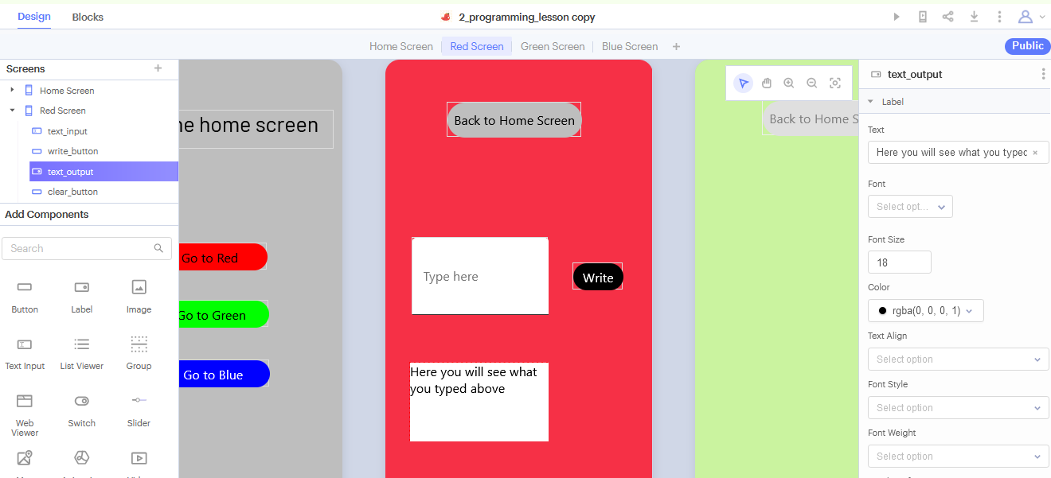
Insert New Text – Label

Slide 8
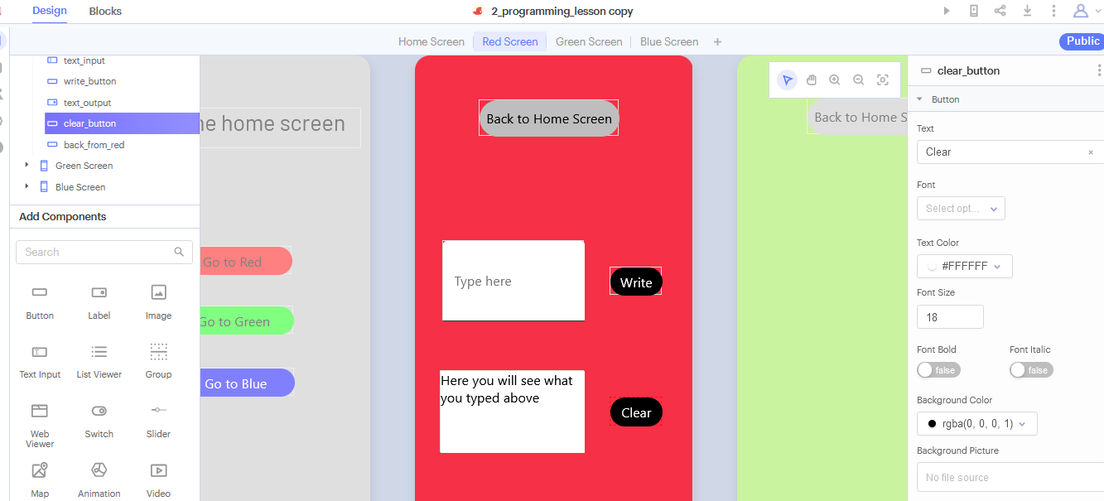
Insert New Text – Clear Button

Slide 9
Insert New Text - Blocks
Steps
Select the red screen
Go to the Blocks page
Create 2 new blocks
Click ‘Web preview’ to see the result
Create a block for write_button
Create a block for clear_button
Click on write_button, drag the block: (…)’s text
Click on write_button, drag the block: set (…)’s text to
Click on write_button, drag the block: set (…)’s text to “Button”
Click on write_button, drag the block: when (…) click & do (…)

Slide 10
Bonus
Display the output only for 5 seconds and then come back to the default text

Slide 11
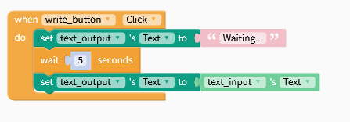
Bonus
Wait 5 seconds before displaying the text, display another message in the meantime

