Slide 1
Thunkable – Login Screen

Slide 2
Overview
Customize first screen
Create new screens
Enhance the Home Screen
Add label
Add buttons
Add code to control buttons
Test the app
Extra Work

Slide 3
Overview
Customise
Customise first screen
Create
Create new screens
Enhance
Enhance the Home Screen
Add label
Add buttons
Add
Add code to control buttons
Test
Test the app
Work
Extra work – if we have time!

Slide 4
Customise
Customise first screen

Slide 5
Customise first screen - Name
Change the name of the screen
Click on three dots next to screen name
Click Rename
Change Screen1 to Home Screen

Slide 6
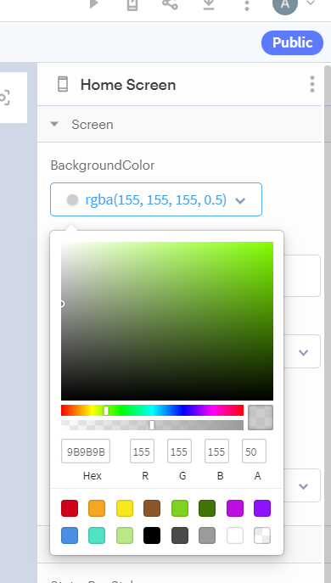
Customise first screen - Colour
Change the background colour
Click BackgroundColor
Enter the values:
155, 155, 155, 50 in the R, G, B, A boxes
(The default grey colour is slightly too dark!)

Slide 7
Create
Create new screens

Slide 8
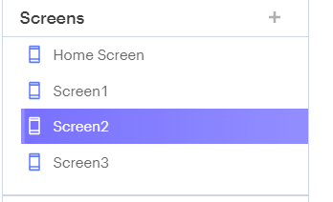
Create new screens - Add
Click the + next to Screens on the left hand side of the screen. Select Create new Screen
Do this 3 times
You should now have:
Home Screen
Screen1
Screen2
Screen3

Slide 9
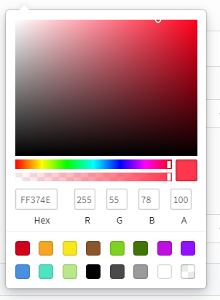
Create new screens – Red screen
Click on Screen1
Change the name to Red Screen
Click on BackgroundColor
Enter these values for RGBA:
255, 55, 78, 100

Slide 10
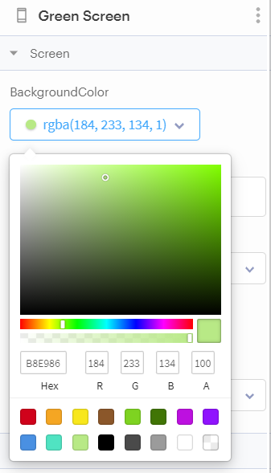
Create new screens – Green screen
Click on Screen2
Change the name to Green Screen
Click on BackgroundColor
Select the light green colour

Slide 11
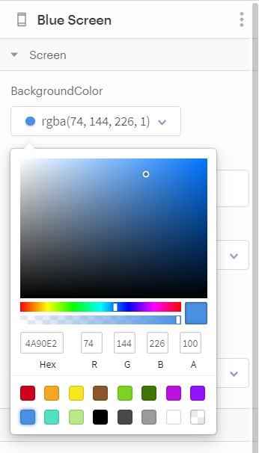
Create new screens – Blue screen
Click on Screen3
Change the name to Blue Screen
Click on BackgroundColor
Enter these values for RGBA:
74, 144, 226, 100

Slide 12
Enhance
Enhance the Home Screen

Slide 13
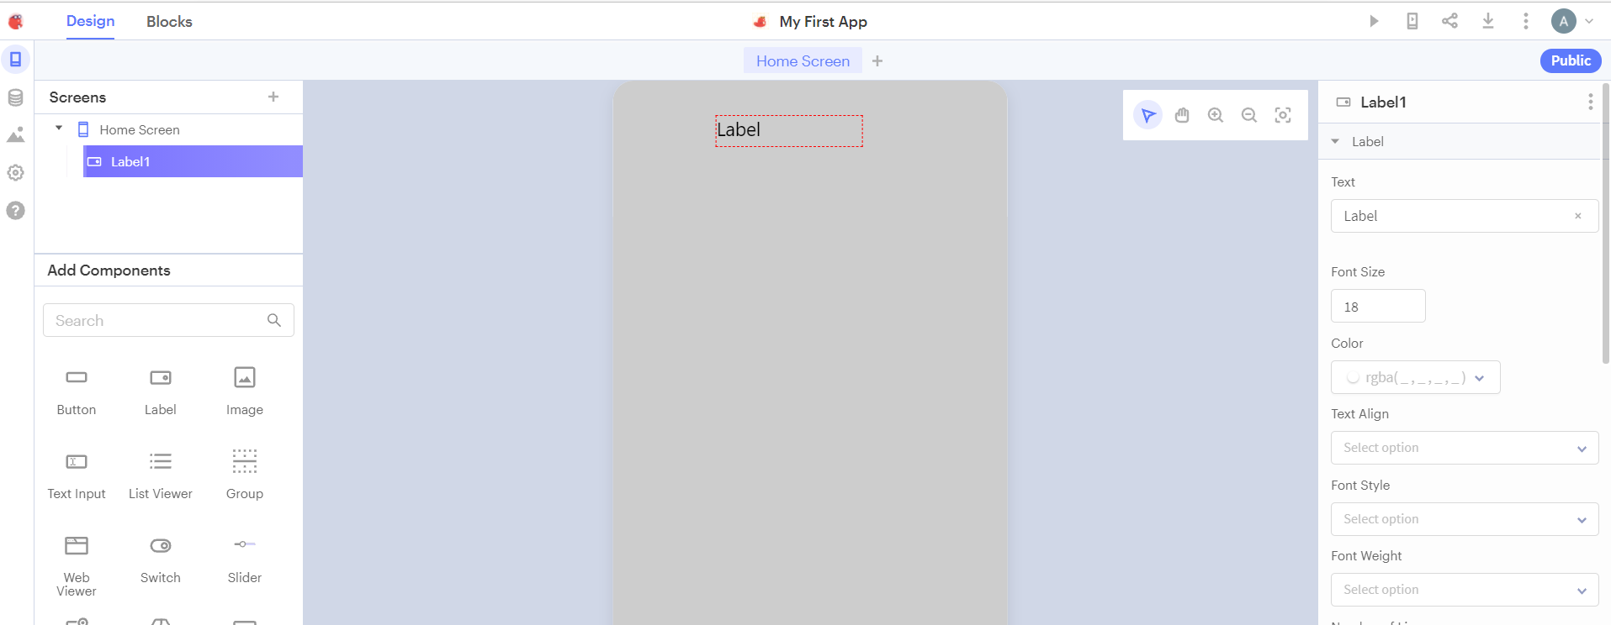
Enhance home screen – Add Label
Add a label:
Click on Home Screen
Click and drag a label component onto the screen

Slide 14
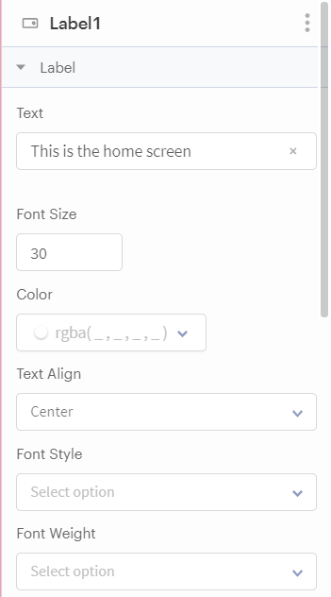
Enhance home screen – Update Label
Change:
Text : This is the home screen
Font Size : 30
Text align : Center

Slide 15
Enhance home screen – Position Label
Adjust size of text box on screen
Left click on white squares at the corner of the text box to make it wider
Click and hold the mouse inside the box
Move it left and right until you see a purple line
This is the centre line
Let go of the mouse here

Slide 16
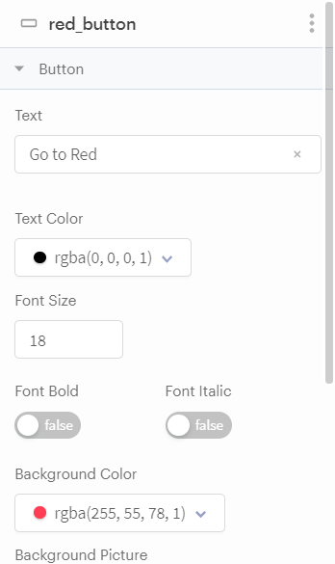
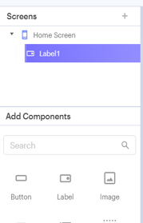
Enhance home screen –Red Button
Drag Button component onto the screen
Rename to red_button
Change text to Go to Red
Change Background Color to 255, 55, 78, 100
Change size and line up to middle (using pink line)

Slide 17
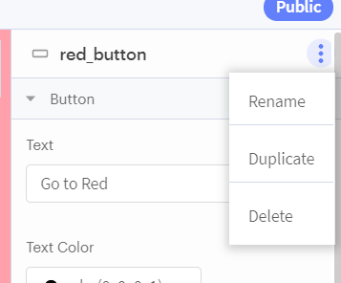
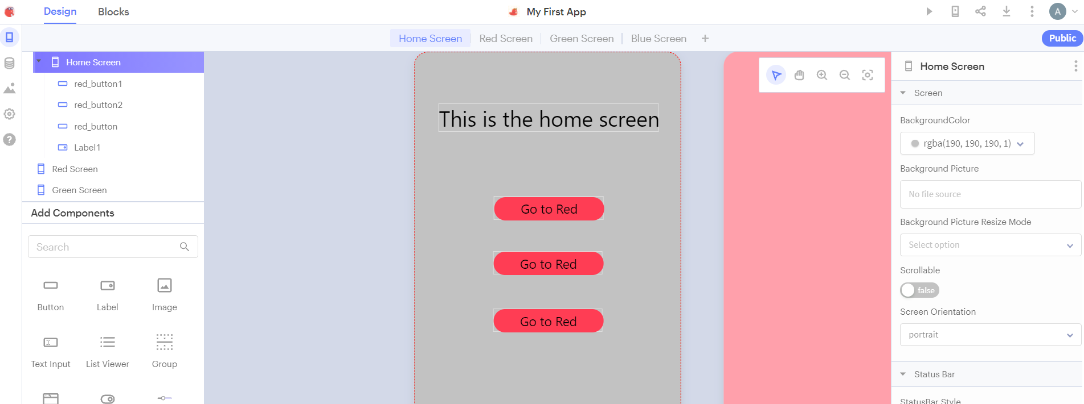
Enhance home screen – Duplicate Button
We’ll use these copies to create the blue and green button
Click on the three dots and Click Duplicate
Do this twice
Click and Drag the new buttons so they line up

Slide 18
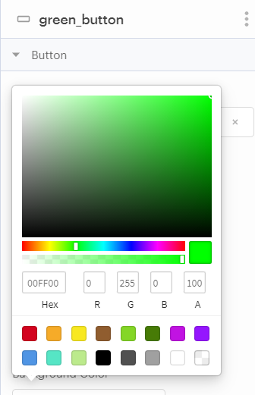
Enhance home screen – Green Button
Click on red_button1 in the left hand side
Rename to green_button
Change text to Go to Green
Change BackgroundColor to 0, 255, 0, 100

Slide 19
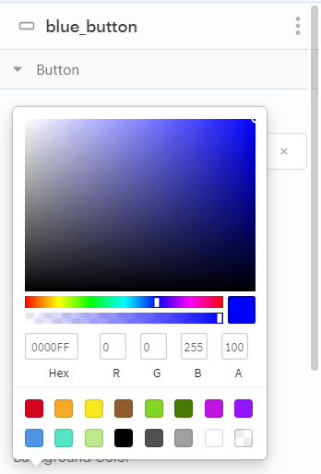
Enhance home screen – Blue Button
Click on red_button2 in the left hand side
Rename to blue_button
Change text to Go to Blue
Change BackgroundColor to 0, 0, 255, 100

Slide 20
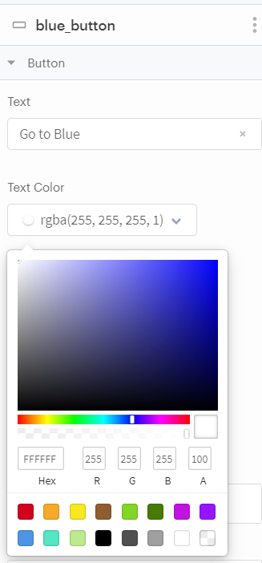
Enhance home screen – Update Blue Button
Black text doesn’t look great with the blue background!
Change the Text Color to white

Slide 21
Add
Add code to control buttons

Slide 22
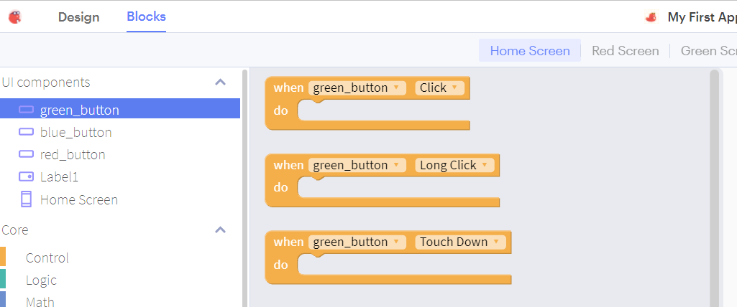
Add code – Green Button
Click Blocks
Click green_button
Click and drag “When green_button Click”

Slide 23
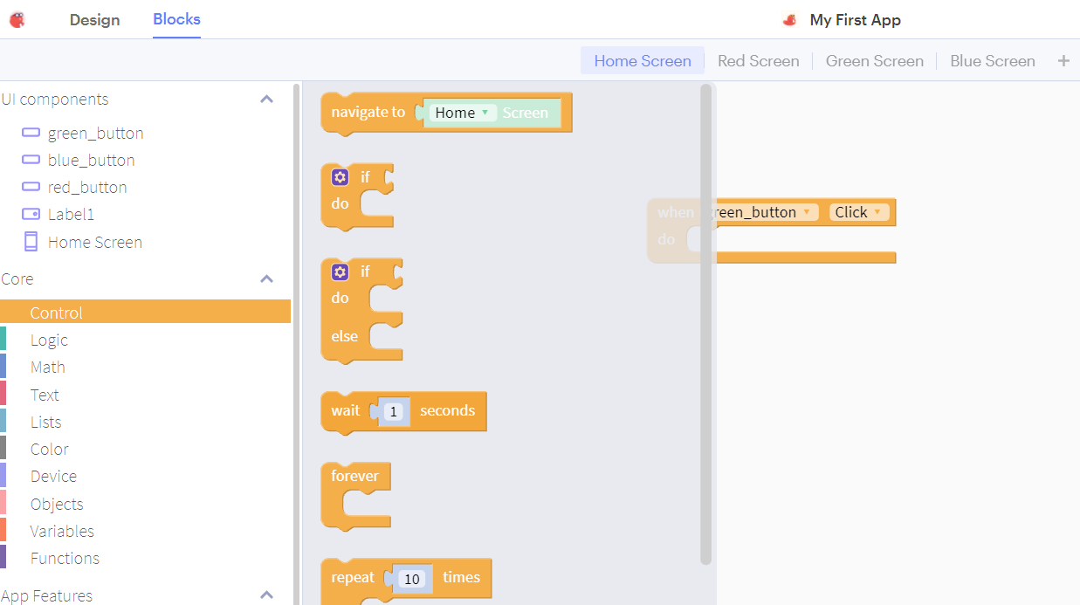
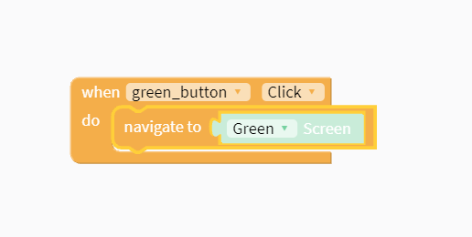
Add code – Add Control block
Click Control
Then click and drag the “navigate to” block
Place it inside the “When green_button Click” block
Change the drop down from Home to Green

Slide 24
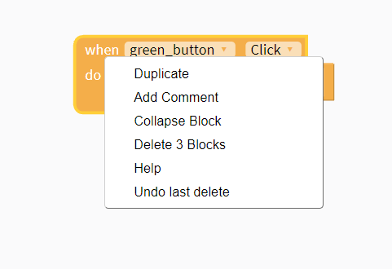
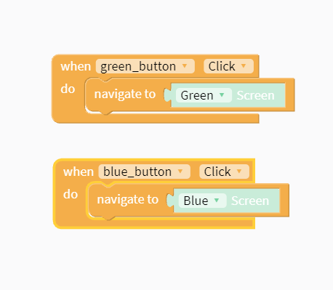
Add code – Blue Button
Use duplicate to clone the screen changing code
Click on Blocks
Right click on the “When green_button Click” block
Select Duplicate
Change the duplicate to the blue button / blue screen

Slide 25
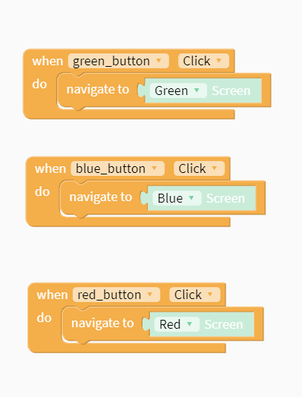
Add code – Red Button
Use duplicate to clone the screen changing code
Click on Blocks
Right click on the “When green_button Click” block
Select Duplicate
Change the duplicate to the red button / red screen

Slide 26
Test
Test the app

Slide 27
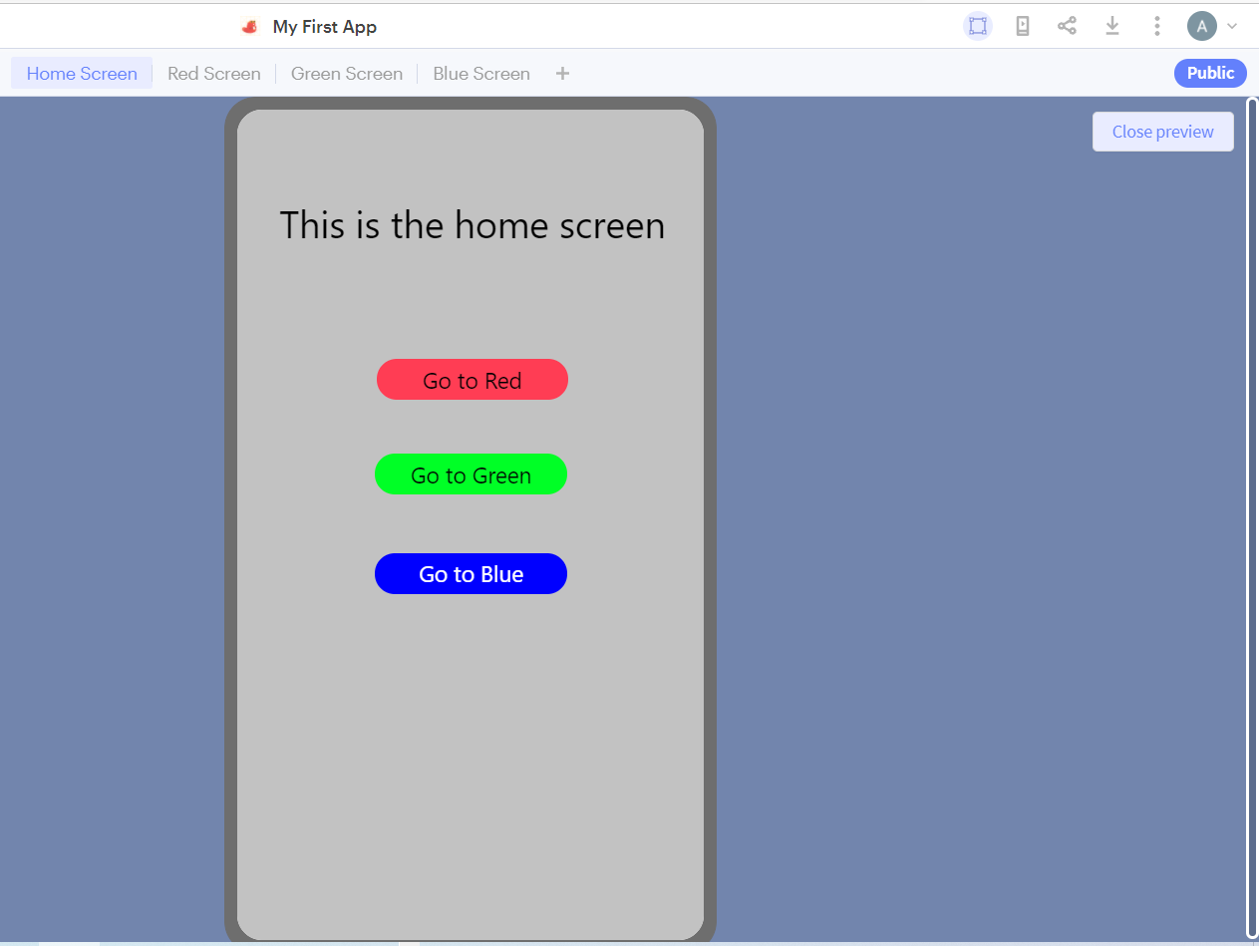
Test the App– Green Button
Click the Web Preview button
If you click “Go to Green”
You go to the green screen.
Click “Close preview” to return

Slide 28
Test the App– Blue and Red Button
Click the Web Preview button
If you click “Go to Blue” you should be directed to the blue screen.
Click “Close preview” to return to the coding window.
Click the Web Preview button
If you click “Go to Red” you should be directed to the red screen.
Click “Close preview” to return to the coding window

Slide 29
Extra
Extra work – if we have time!

Slide 30
Extra Stuff
Wait 5 secs before moving to the new screen
Add speech to say “Red Button pressed” when you click the red button

Slide 31
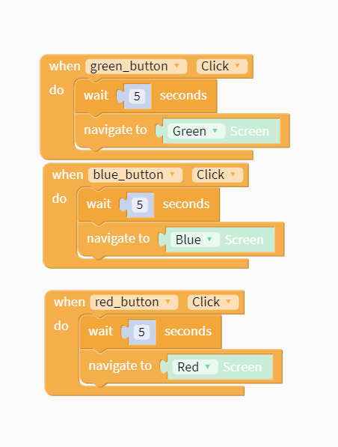
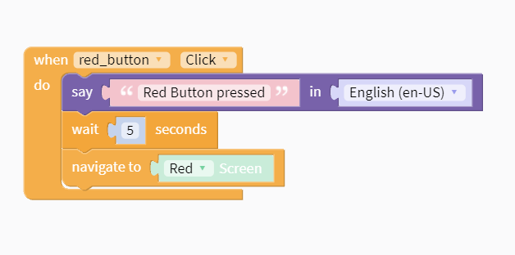
Extra Stuff - Solution

