Slide 1
www.makeithappen.club
Notes:
Good Morning (School Name), it is wonderful for Make it Happen to be back with you to share some exciting news. My name is…
A few months ago you had a visit from one of our volunteers who launched your schools app design competition. Each of you were challenged to design and app idea, ideally something that would help someone, solve a problem or entertain someone. We have to say, the ideas you came up with were incredible. Before we go any further we want to say a hugh congratulations to you and all and give each and every one of you a big round of applause for your incredible work on this app design competition.

Slide 2
Inspiring ideas
Notes:
After you completed your ideas, we took those ideas away and say down with an amazing team of volunteers who helped us to select our runners up and winners but duing that process many of you inspired us. Many of your ideas were so amazing that they inspired our volunteers who work with apps everyday and we knew we had to recognise them. I have lots of Inspiring Ideas Certificates that we are going to give out now.
(Depending on logistics you can invite pupils forward to receive these or as them to stand where they are seated)

Slide 3
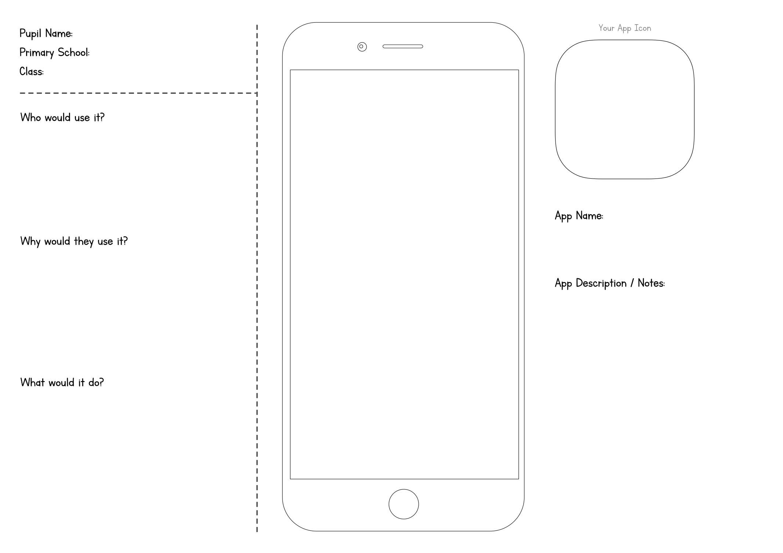
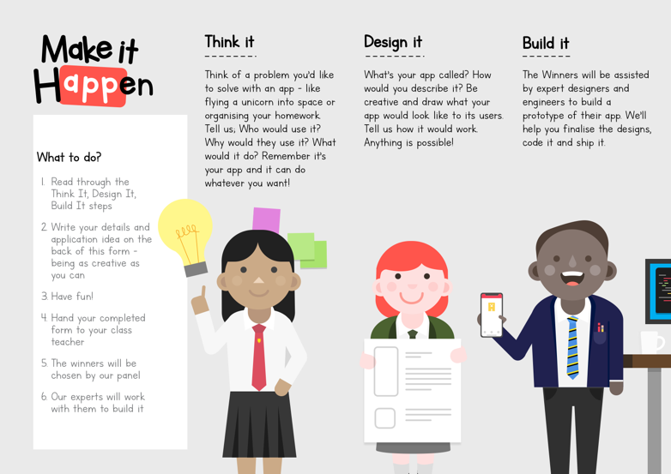
Runners up - 1
Notes:
Now let’s get onto our prize winners. You did not make out job easy when it can to selecting a top 3 but we reached a decision and your first runner up from (school name) is, -drum rolls encouraged!!!

Slide 4
Runner up – [pupil name and class]
[app name]
Picture of entry
Notes:
Congratulations to….
Brief overview of the app

Slide 5
Runners up - 2
Notes:
Now for our second Runner up… Drum Roll Please…!!!

Slide 6
Runner up – [pupil name and class]
[app name]
Picture of entry
Notes:
Congratulations to….
Brief overview of the app

Slide 7
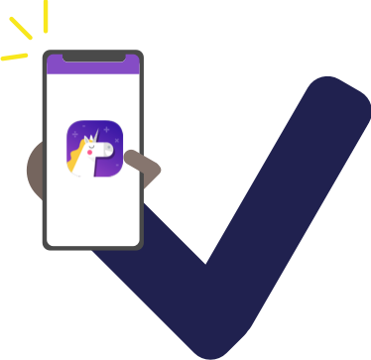
Winner
Notes:
Finally, the moment you have all been waiting for. We are finally ready to announce the winner of the Make it Happen App Design Competition and show you the winning app that has now been created….
Your winner is…

Slide 8
Winner – [pupil name + class]
[app name]
Picture of entry
Screenshot
Screenshot
Icon
Notes:
Pupil will come to collect prize and certificates. Demo live app.
Thank you so much for having us at… we have loved working with you all and have been blown away by your incredible creativity and imagination. Thank you and a big well done to everyone involved.
Following assembly you can work on the app with the pupil and a few friends. This allows them to make any changes or look at the code.
Remind staff that we are on social media so any pictures or media being shared can also tag us.
Feedback will be sent to school following the visits.
Make sure all entry forms are returned to the school contact and links are provided so the school can access the app.

Slide 9
What’s next…
Finish the winning app idea today
Download and play the winning app
You can take all your ideas forward – thunkable.com
www.makeithappen.club

