Slide 1

Designing an Application

Slide 2
YouTube
Examples of apps
Facebook
Amazon
Uber
Netflix
Chase Bank
People connected through collaboration and practice
Notes:
Why do we create apps?
Online shopping, banking, software within Cars, Planes, Space, booking holidays.
We will take a look at some apps and think about these questions
Who would use it?
Why would they use it?
What does it do?
Is it good design and how could you change design?
How could you add more features to these apps?

Slide 3
Booking a holiday
Online shopping
Requesting an appointment e.g. doctor
Why do we need apps?
Online banking
Gaming
Interesting fact from business.com:
70% of mobile phone time is spent on apps
People connected through collaboration and practice
Notes:
Why do we create apps?
Online shopping, banking, software within Cars, Planes, Space, booking holidays.
We will take a look at some apps and think about these questions
Who would use it?
Why would they use it?
What does it do?
Is it good design and how could you change design?
How could you add more features to these apps?

Slide 4
App Design
Idea generation
Develop visual features
Development
Coding and building you app
Stages of building
an application
Testing
Find and fix issues
Launching
Release your app
Share it with friends and family
People connected through collaboration and practice

Slide 5
Keep design simple and ensure its easy to navigate through the app.
Don’t clutter a screen with lots of images.
Consider font size and weight
Choose colours that contrast
For mobile apps, consider what works well on a small screen
Design for what is likely to appeal to your target audience
Factors to consider
for designing
an application
People connected through collaboration and practice

Slide 6
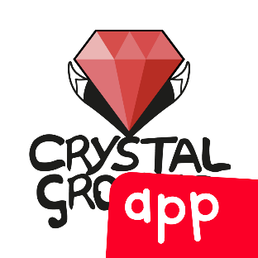



MakeitHappen.club/Winners
Review design of
Thunkable applications
Crystal Ground
Space Rocket Maths
Unicorn Personal Trainer
Learn to Code
People connected through collaboration and practice

Slide 7
MakeitHappen.club
Want to
design an app yourself?
Menu – About
Scroll down to Sounds Awesome What do I do?
People connected through collaboration and practice

Slide 8
Thank you

